Slide 1

Smart Places and Things​
Alex de Boer
Twitter: @alexdeboer
LinkedIn: /in/alexdeboer/
AI bootcamp – finding project topics
October 2020
Notes:
Software architect and AI enthusiast.
Work in the Smart Places and Things department

Slide 2
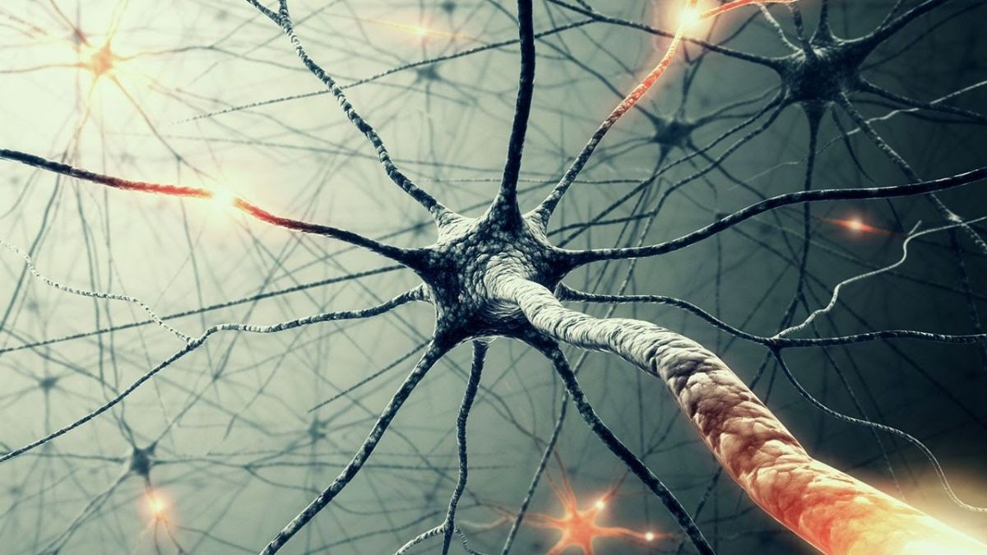
Content
Smart Places and Things introduction
AI (in general and machine vision)
Applied AI - Machine vision tasks
Smart Places and Things - applied AI examples
Where to use AI? Finding project topics by looking at business processes
Project topics / datasets

Slide 3

Smart Places and Things – introduction
“Help customers by delivering accurate real-world observations of people, vehicles, assets and their status/information to gain insights in what is happening in a business ecosystem.”
“Manage and optimize the use of scarce resources/assets by IoT.”
Notes:
Active in the following area’s:
Digital City, enforcement, logistics and ports

Slide 4
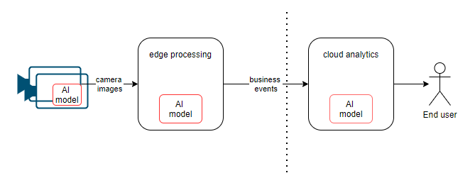
Smart Places and Things – introduction II
Real world IoT sensing (and actuation) of
people, vehicles, assets and places
with (centralized) intelligence for analytics
Typical system setup:
Notes:
Maybe I can clarify that a bit by giving an example of a typical setup of a SPT system.
Sometimes AI model is integrated in the camera.
Sometimes images are streamed to the cloud and the AI model on the edge is skipped (only AI model in the cloud) or
The other way around: AI on the edge and no cloud.

Slide 5
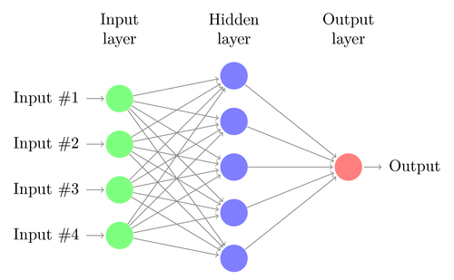
Applied AI – AI/ML in general AI models from the moon
X Y
A mapping from input X to output Y
Use information that you do have (X) to generate information that you don’t have (Y)
Notes:
Take a step back. / Lets look at AI models from the moon / helicopter perspective.
use information that you do have to generate information that you don’t have
For examples:
Generate the information “price of a house” from the number of square meters of a house
Generate the information “spam/no spam” from the text of an email

Slide 6

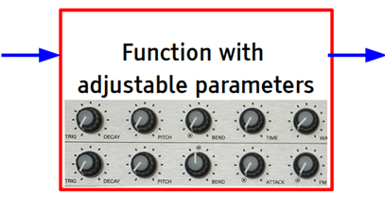
Applied AI – AI/ML in general AI models from the moon II
X Y
The mapping from input X to output Y is learned
(supervised learning).
It is also called a “prediction”. I.e. there is uncertainty in the predicted Y being correct
To be able to learn the mapping, “Y needs to be predictable from X.”
Notes:
In other words: predict unknown datapoint Y from the given datapoints X
Note that it is a prediction. I.e. there is uncertainty in the predicted Y being correct. (remember: the False Positive and False negative cases you saw in the YouTube video playlist)
A prediction can be about the future (in the normal meaning of the word prediction). But it could also be a prediction about the present or even the past.
X and Y need to correlate to each other: Predicting the housing price from the number of tea leaves in your mug wont work.

Slide 7
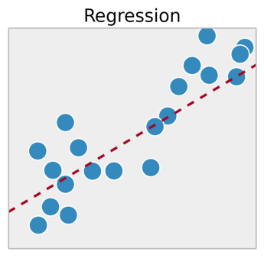
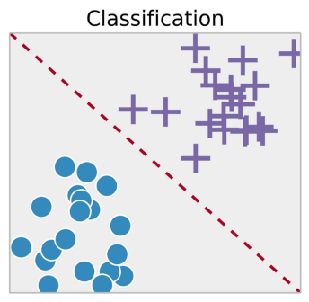
Applied AI – AI/ML in general 2 basic types: classification & regression
Output:Y
Input: X2
Output Y:
Cross or point (blue or purple)
Input: X
Input: X1
Output Y is continuous
Output Y is discrete
Notes:
Learning with a lot of examples = supervised learning task.
Basic types of AI models are regression and classification
The AI models (or problems) are categorized by their output Y
Regression:
The Y’s that we are predicting is continuous
Classification:
The Y’s that we are predicting are discrete (or binary).

Slide 8

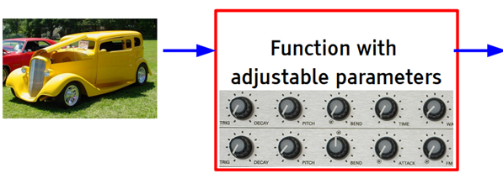
Applied AI – machine vision (perception)
car / no car
X Y
SPT applies AI/ML for “sensing the environment” / machine vision. We use:
images as input X and
a special kind of learnable function. (deep convolutional neural net)
Notes:
The function with adjustable parameters is a deep neural net that is specialized for vision / image processing: it is a so called deep convolutional neural network.
There are other specialised area of AI that use special kinds of learnable functions:
NLP (Natural language processing):
Sentiment analysis: input: tweets output: classification: sad / happy
Language translation: input: English text output: Chinese text
Code conversion: input: Fortran program output: Java program
Take derivative input: Mathematical function output: derivative of the function
QUIZ question: what type of AI model is this? Classification or regression?

Slide 9

Applied AI – machine vision tasks
Notes:
SPT is using the first three. (classification and object detection).
Other machine vision task:
- Human pose estimation (activity detection)
- Vehicle re-identification
Advice:

Slide 10
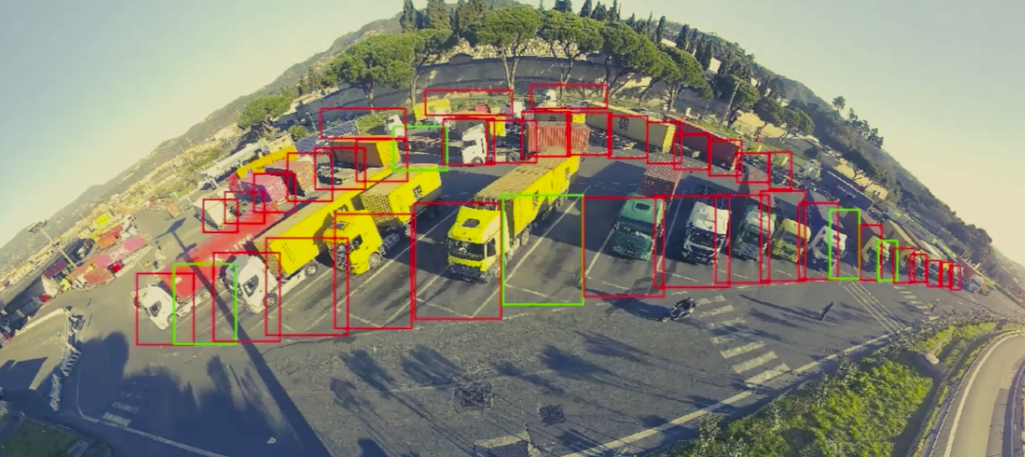
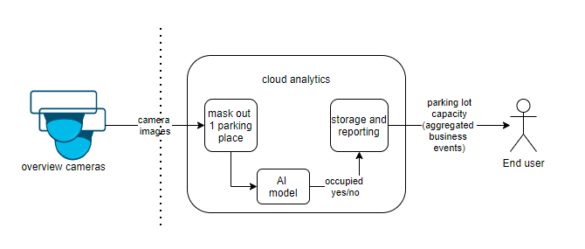
SPT applied AI example I: Intelligent Truck Parking
AI model:
input X: image of 1 parking space masked out from overview camera image
Output Y: parking space occupied yes/no
Machine vision task: image classification (binary)
Notes:
Smart AI cameras observe parking lot availability of the Italian Port “La Spezia”.
Predefined masks per parking space
It reports space availability on the aggregate of these twins. It manages and
optimizes the use of scarce resources/assets (parking space) by IoT.
Using the gained situation awareness to improve business operations (better throughput of the port).

Slide 11
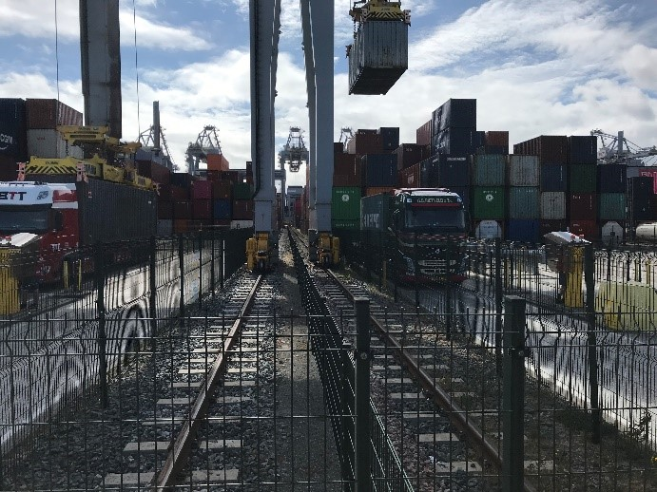
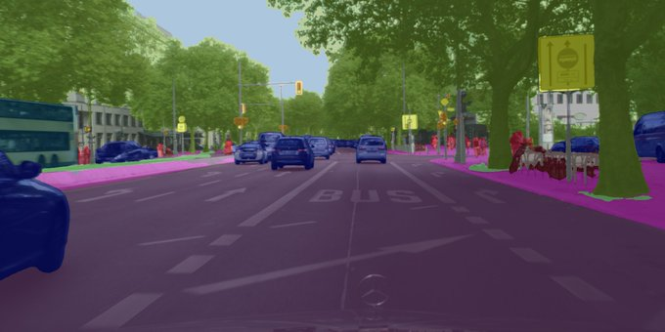
SPT applied AI example II: Rotterdam World Gateway
Automated stacking crane anti-collision (bid phase)
Driveable area detection AI model:
Input X: images from camera on crane leg
Output Y: segmented images (drivable / non drivable area)
Machine vision task: segmentation
Notes:
Multilabel weather recognition AI model:
Input X: image of overview camera
Output Y: heavy rain / fog / clear
Machine vision task: multilabel classification

Slide 12
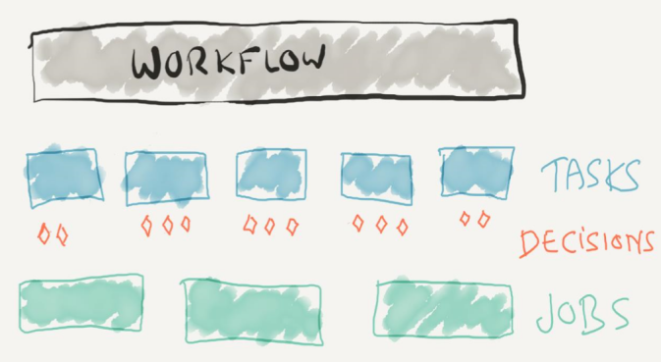
Finding AI problem by looking at business process
Business process re-engineering with AI
Notes:
Another way to look at it: TOOLS to find where AI can be used.
Business process re-engineering with AI. Business process redesign / re-engineering (Hammer en Champy) used to be with automation (arithmetic) in mind. We can do the same with AI (prediction) in mind.
look for individual DECISIONS ←
Because prediction is input for decision making
Example within DXC:
- Decision: do we want to peruse a bid on not.

Slide 13
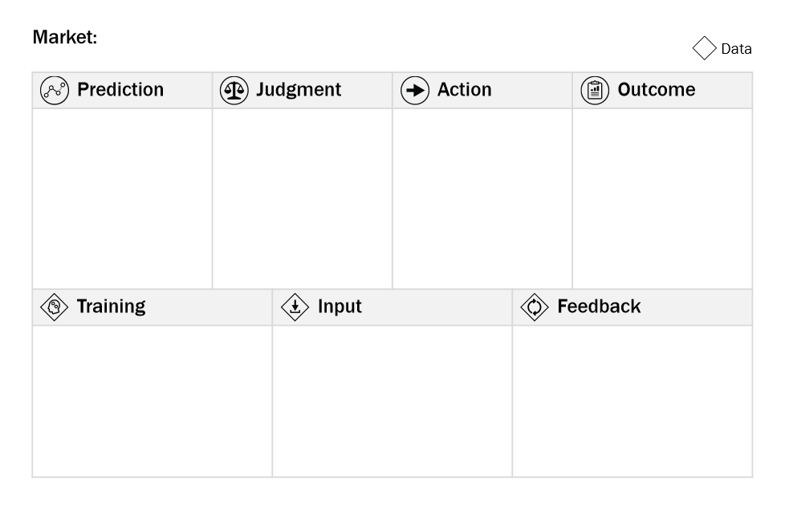
Finding AI problem by looking at business process
Business process re-engineering with AI
AI canvas
Notes:
For each decision fill in the AI Canvas:
Top row describes components of the decision
steps:
- prediction: what predictions are necessary for the decision. -> probability of winning the bid yes/no
- judgement: pursue bid
- action: start the bid process
- outcome: higher win rate.
Bottom row describes the data for the AI model to make the prediction:
data:
- training: do we have data to train the AI model with. I.e. do we have examples X and corresponding correct answers Y? That correlate with each other
- input: do we have data to predict with when the AI model is trained
- feedback: data to further train with

Slide 14
How to find project topics / annotated datasets?
Some hints:
Look for decisions in business process and use AI canvas to find decisions with suitable data:
Use the existing business data and label it.
Create new (input) data for the problem at hand: use a (mobile phone) camera.
Look for existing datasets on the topic you are interested in:
Google: “xxx dataset” or “xxx challenge” (where “xxx” is your problem)
https://www.kaggle.com/datasets
Arxiv.org papers -> links to existing research datasets in the papers
Note: type of AI model should be supported by the notebook.
Notes:
Neural net architecture supported by notebook?
Better not use complex Natural Language processing or complex machine vision tasks
The goal of the bootcamp is to get your first AI model up and running.
Suggest to start with basic tabular data (for input X) or
If you want to do a machine vision project task as project topic. Take a classification task
Because labelling a classification dataset is do-able. Object detection and segmentation takes more effort.

Slide 15
Alex de Boer
Twitter: @alexdeboer
LinkedIn: /in/alexdeboer/
Thank you!
Notes:
Thank you for your attention and
happy topic hunting!

Slide 16
Backup slides
Notes:
If you are looking for your own AI model and want to use machine vision I would advice to keep it simple: only use classification. It looks simple but can be very powerful. As you will see in the following examples.

Slide 17
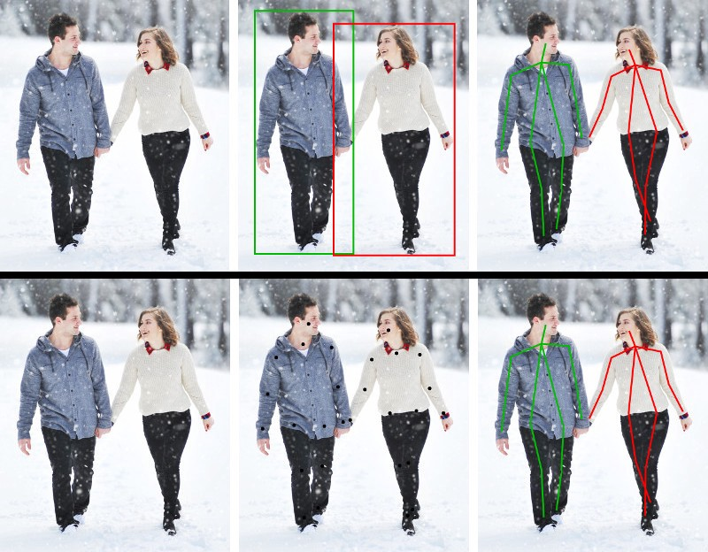
Applied AI – machine vision tasks II
Human pose estimation / activity detection
Notes:
If you are looking for your own AI model and want to use machine vision I would advice to keep it simple: only use classification. It looks simple but can be very powerful. As you will see in the following examples.

Slide 18
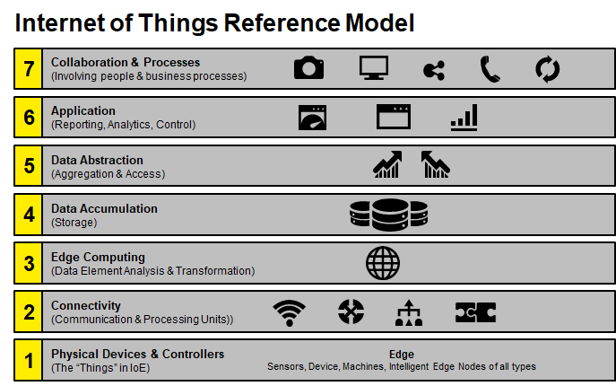
DXC IoT Reference Model
Problem/Process
Analytics/Application
Integration (platforms)
Partner Ecosystem
Network
Things
Responsiveness increases as network and analytic latencies decrease
Notes:
Different layers of the IoT reference model – highlights emphasis on partners for the lower tiers of the model with DXC/Luxoft strengths in the upper layers.
ITP maps quite nicely to the DXC IoT reference model: 1. physical devices / controllers / edge = camera's 2. connectivity = network for the secure access to the camera streams/images 3. edge computing: AI models for computer vision to transform the camera images into parking space occupied yes/no business event 4. data accumulation: storage of the business events 5. data abstraction: abstracting the camera images to business events (individual parking space occupied yes/no) to aggregated business events (parking space availability %) 6. application: reporting the parking space availability 7. collaboration and process: collaboration with the truck driver in order to solve the business problem.

Slide 19
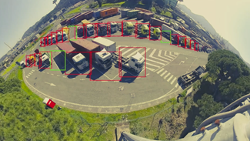
Intelligent Truck Parking
Case study
Challenge
Limited parking space, resulting in traffic jams, rogue and dangerous parking
Traffic congestion caused by heavy trucks arriving (unplanned) at the Port
Insufficient parking for trucks at the port staging area
Pollution caused by trucks idling at the port gate and staging areas, extra trips to the back port
No integration of truck scheduling system with traffic monitoring, driver assignment, or parking systems
Port Operator/Terminal Operators
Manage roads
Enhance the port’s competitive position as a logistics hub and world-class industrial complex, in terms of size and with regard to quality.
Develop, manage and exploit the port in a sustainable way and to deliver speedy and safe services for shipping.
Solution
Identify and forecast parking occupancy and capacity
Identify and forecast incoming traffic
Plan parking buffer occupation based on terminal freight handling activity
Assisted guidance for truck drivers for freight handling and parking.
Common operational picture for Port Authority and PCS users
Results
Reduced truck congestion by​:
Offering real-time parking availability, based on calculated parking occupancy, container status & traffic information to involved truck drivers
Truck drivers can send ETA for Realtime traffic analysis to city and port agencies to give them time to respond with necessary actions where and when necessary

Slide 20
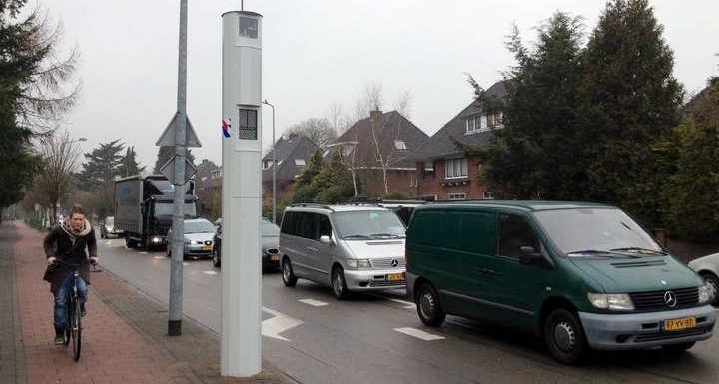
Spot Speed and Red-Light Enforcement
Case study
Challenge
Road safety at dangerous intersections because of speeding and red-light negation
NOx and other environmentally harmful emissions
Noise pollution
Solution
Netherlands Public Prosecution Office
Gives advice on traffic laws and regulations to other parts of the Public Prosecution Service, the judiciary and the police
Loops in the road that detect the vehicles approaching the intersection;
Camera and Infrared flash for taking images of vehicles who speed or ignore the red traffic lights;
Certified vehicle detection device to measure spot speed
Build in electronics at the edge for preprocessing and transmitting the data;
Wireless network for data communications to central servers;
Processing servers to read license plates;
Processing back office software for handling fines.
Results
29% on average reduction of severe accidents with fatalities caused by speeding
18% on average reduction of sever accidents with fatalities caused by red light negation
50% accident reduction in general
20-25% lower emission (NO2 and PM10)
54%
Less violations in speed
50%
Accident reduction

Slide 21
Applied AI – AI/ML in general prediction – but not as we know it.
- A prediction can be about the future (in the normal meaning of the word prediction). But it could also be a prediction about the present or even the past.
- it is a prediction in the sense that the algorithm is uncertain about the correctness of the given prediction of Y.
Notes:
Future examples:
will the engine break down in the coming week
what will a customer order?
DXC: will a bid be successful?
Present examples:
DXC: what type of vehicle is on that picture
medical diagnosis
Autonomous driving

Slide 22

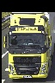

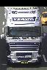
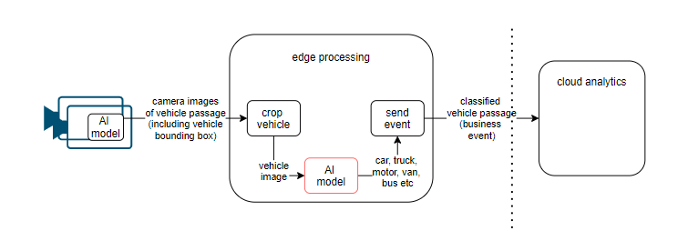




Offering Specific – SPT example
SPT applied AI example II: Vehicle classification
AI model:
Input X: vehicle image
Output Y: car / truck / motor / bus / van etc.
machine vision task: image classification (multi label)
Notes:
Vehicle classification used to be done with expensive hardware. Thanks to AI this can now be done “in-image”. Meaning from a camera image.

